Slide 1
Binary Trees,
Binary Search Trees

Slide 2
Trees
Linear access time of linked lists is prohibitive
  Does there exist any simple data structure for which the running time of most operations (search, insert, delete) is O(log N)?

Slide 3
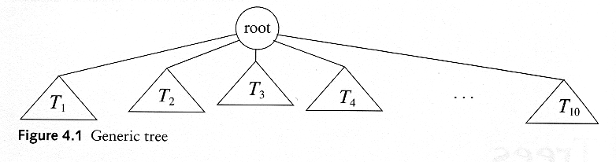
Trees
A tree is a collection of nodes
  The collection can be empty
  (recursive definition) If not empty, a tree consists of a distinguished node r (the root), and zero or more nonempty subtrees T₁, T₂, ...., T_{k}, each of whose roots are connected by a directed edge from r

Slide 4
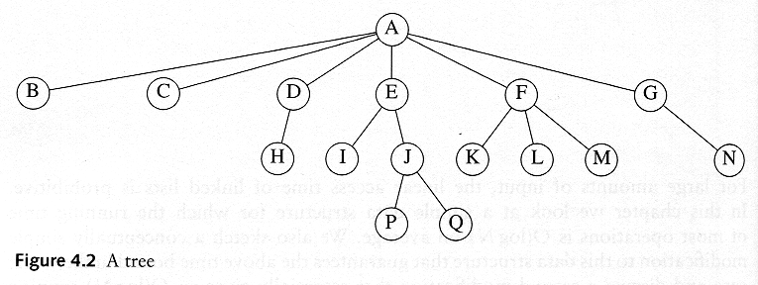
Some Terminologies
Child and parent
  Every node except the root has one parent
  A node can have an arbitrary number of children
Leaves
  Nodes with no children
Sibling
  nodes with same parent

Slide 5
Some Terminologies
Path
Length
  number of edges on the path
Depth of a node
  length of the unique path from the root to that node
  The depth of a tree is equal to the depth of the deepest leaf
Height of a node
  length of the longest path from that node to a leaf
  all leaves are at height 0
  The height of a tree is equal to the height of the root
Ancestor and descendant
  Proper ancestor and proper descendant

Slide 6
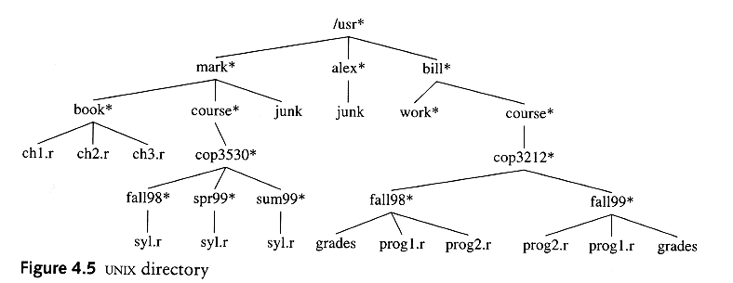
Example: UNIX Directory

Slide 7
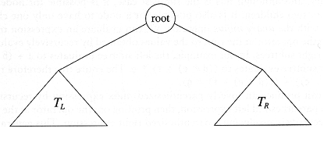
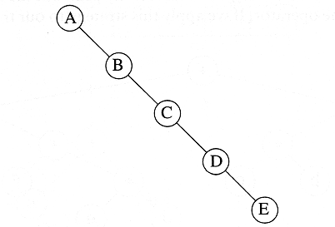
Binary Trees
A tree in which no node can have more than two children
The depth of an “average” binary tree is considerably smaller than N, eventhough in the worst case, the depth can be as large as N – 1.

Slide 8
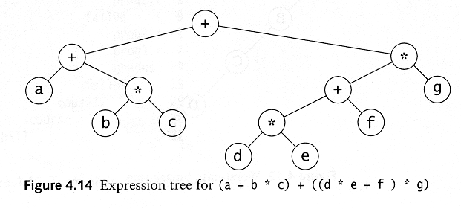
Example: Expression Trees
Leaves are operands (constants or variables)
The other nodes (internal nodes) contain operators
Will not be a binary tree if some operators are not binary

Slide 9
Tree traversal
Used to print out the data in a tree in a certain order
Pre-order traversal
  Print the data at the root
  Recursively print out all data in the left subtree
  Recursively print out all data in the right subtree

Slide 10
Preorder, Postorder and Inorder
Preorder traversal
  node, left, right
  prefix expression
    ++a*bc*+*defg

Slide 11
Preorder, Postorder and Inorder
Postorder traversal
  left, right, node
  postfix expression
    abc*+de*f+g*+
Inorder traversal
  left, node, right.
  infix expression
    a+b*c+d*e+f*g

Slide 12
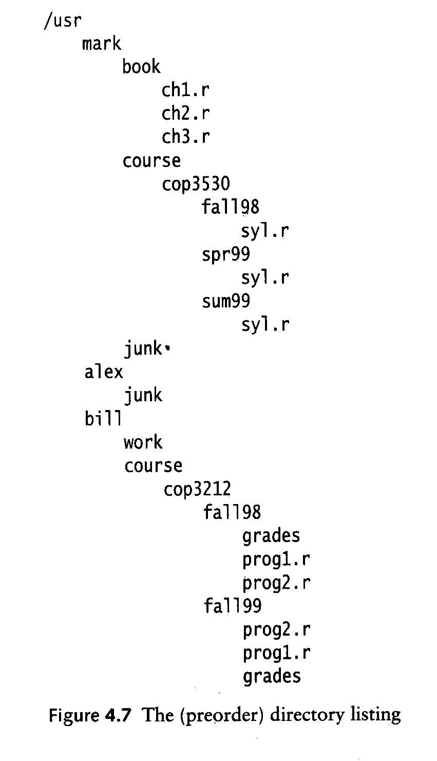
Preorder

Slide 13
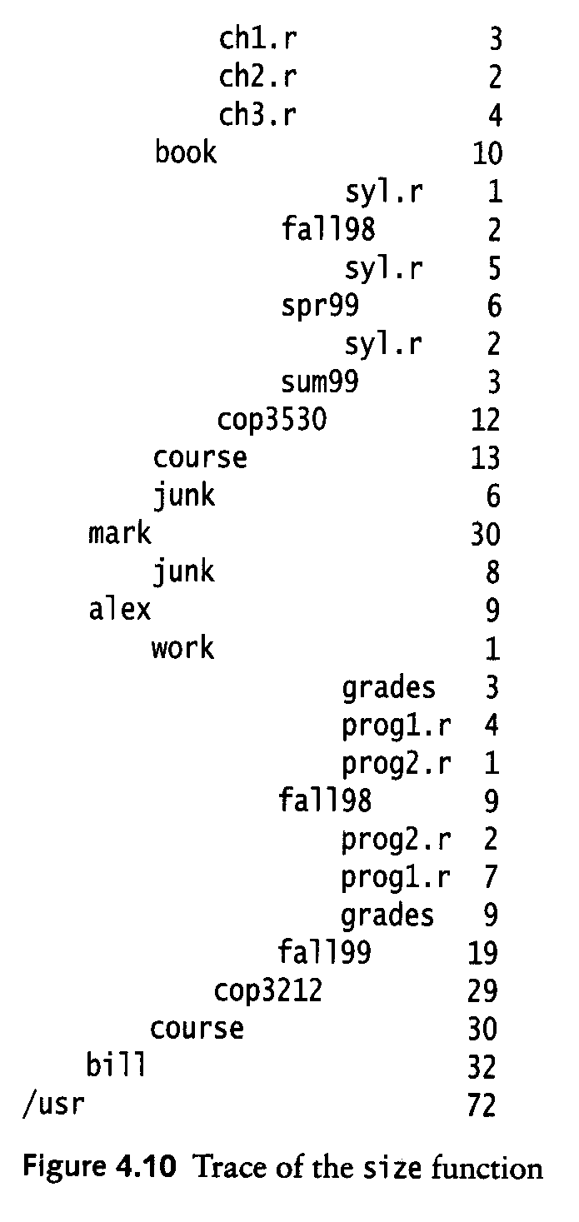
Postorder

Slide 14
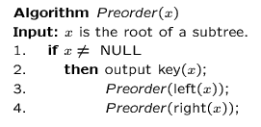
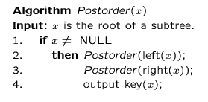
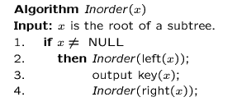
Preorder, Postorder and Inorder

Slide 15
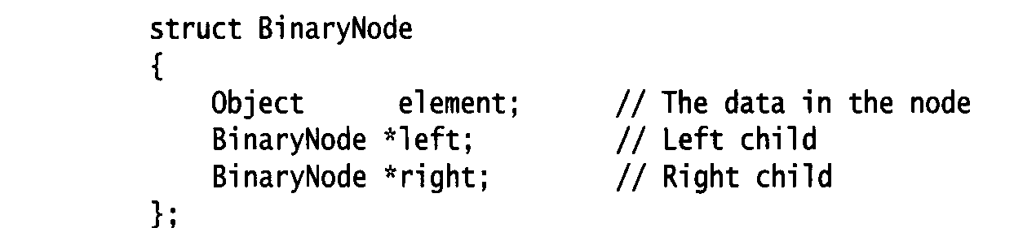
Binary Trees
Possible operations on the Binary Tree ADT
  parent
  left_child, right_child
  sibling
  root, etc
Implementation
  Because a binary tree has at most two children, we can keep direct pointers to them

Slide 16
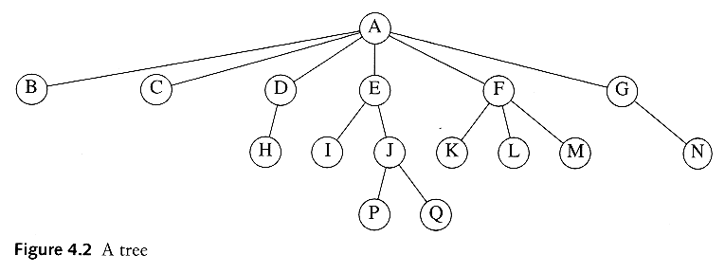
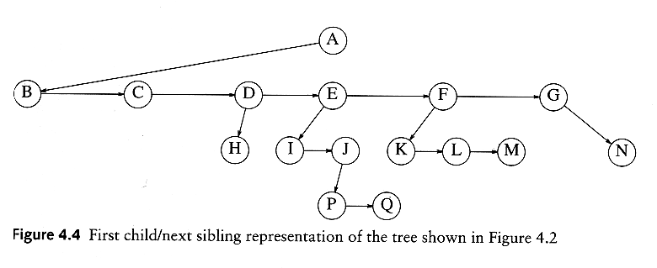
compare: Implementation of a general tree

Slide 17
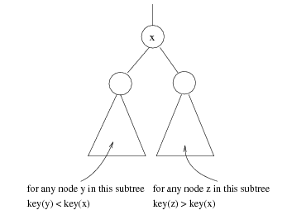
Binary Search Trees
Stores keys in the nodes in a way so that searching, insertion and deletion can be done efficiently.
Binary search tree property
  For every node X, all the keys in its left subtree are smaller than the key value in X, and all the keys in its right subtree are larger than the key value in X

Slide 18

Binary Search Trees
A binary search tree
Not a binary search tree

Slide 19

Binary search trees
Two binary search trees representing
the same set:
Average depth of a node is O(log N); maximum depth of a node is O(N)

Slide 20
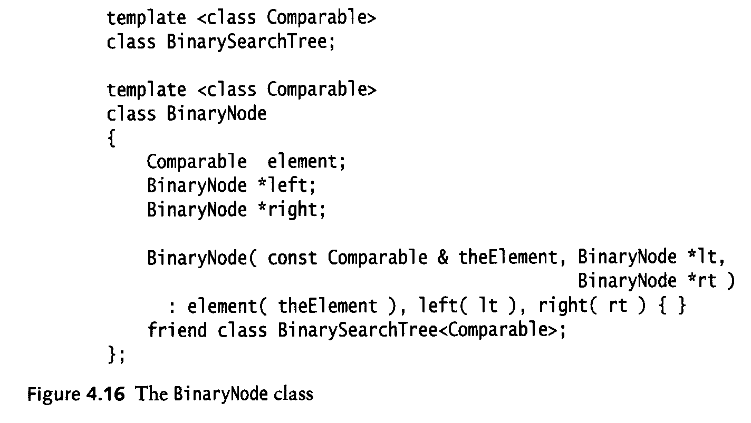
Implementation

Slide 21
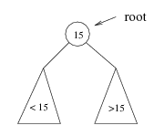
Searching BST
If we are searching for 15, then we are done.
If we are searching for a key < 15, then we should search in the left subtree.
If we are searching for a key > 15, then we should search in the right subtree.

Slide 22
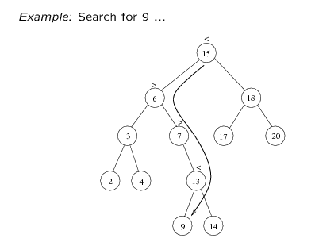
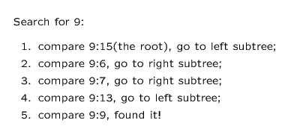

Slide 23
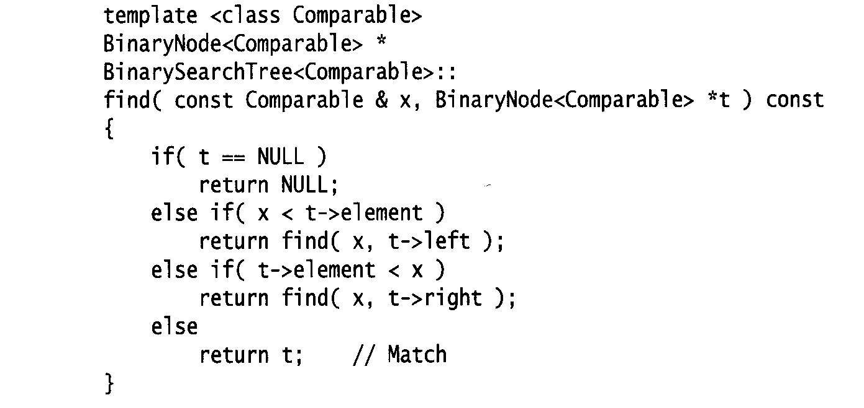
Searching (Find)
Find X: return a pointer to the node that has key X, or NULL if there is no such node
Time complexity
  O(height of the tree)

Slide 24
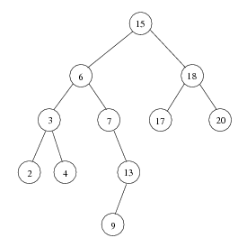
Inorder traversal of BST
Print out all the keys in sorted order
Inorder: 2, 3, 4, 6, 7, 9, 13, 15, 17, 18, 20

Slide 25
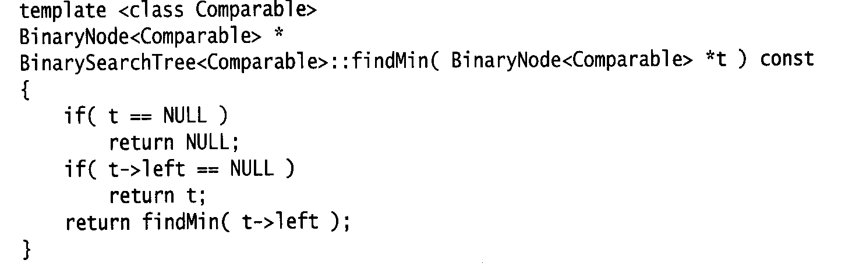
findMin/ findMax
Return the node containing the smallest element in the tree
Start at the root and go left as long as there is a left child. The stopping point is the smallest element
Similarly for findMax
Time complexity = O(height of the tree)

Slide 26
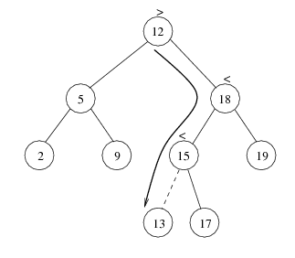
insert
Proceed down the tree as you would with a find
If X is found, do nothing (or update something)
Otherwise, insert X at the last spot on the path traversed
Time complexity = O(height of the tree)

Slide 27
delete
When we delete a node, we need to consider how we take care of the children of the deleted node.
  This has to be done such that the property of the search tree is maintained.

Slide 28
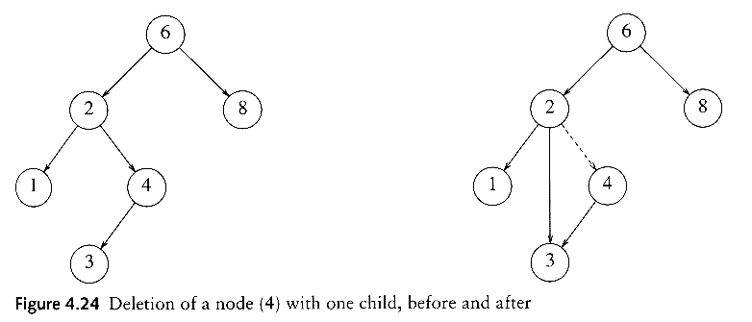
delete
Three cases:
(1) the node is a leaf
  Delete it immediately
(2) the node has one child
  Adjust a pointer from the parent to bypass that node

Slide 29
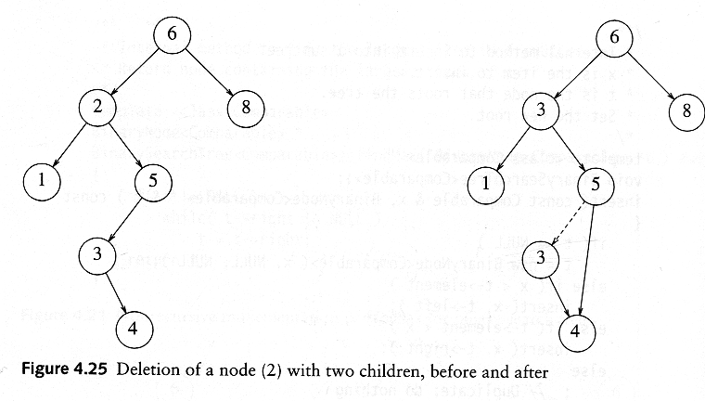
delete
(3) the node has 2 children
  replace the key of that node with the minimum element at the right subtree
  delete the minimum element
    Has either no child or only right child because if it has a left child, that left child would be smaller and would have been chosen. So invoke case 1 or 2.
Time complexity = O(height of the tree)

